Slide 1

PREDICTIVE ANALYTICS
Submitted To: Dr. Achala Shakya
Submitted By:
Name | SAP ID | Branch
Siddharth Joshi | 500107461 | CSE AIML(Hons.)
Rishabh Verma | 500108272 | CSE AIML(Hons.)

Slide 2

Agriculture Crop Price and Health Detection
Welcome to our innovative crop management solution. This system combines advanced image processing and machine learning to predict crop health and prices for wheat, potato, rice, and tomato in Indian markets.

Slide 3

MobileVNet for Crop Health Analysis
1
Leaf-based Detection
2
Real-time Results
Farmers receive instant health assessments, enabling prompt action against diseases and pests.
MobileVNet analyses leaf images to identify crop health issues quickly and accurately.
3
User-friendly Interface
The mobile app simplifies complex AI technology for easy use by farmers.

Slide 4
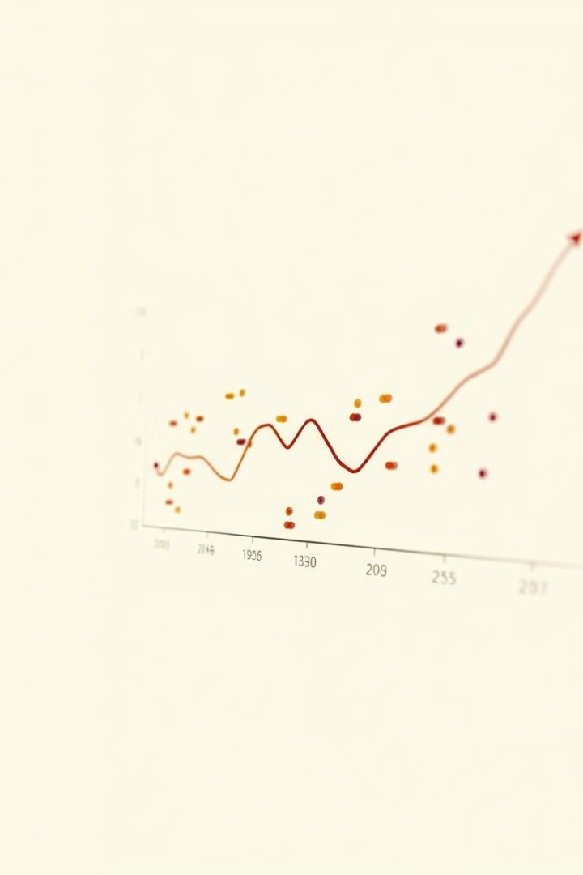
Linear Regression for Price Prediction
1
Data Collection
Market data from various Indian states and districts is gathered and processed.
2
Model Training
Linear regression algorithms learn from historical price patterns and market factors.
3
Price Forecasting
The system generates accurate price predictions for informed decision-making by farmers.

Slide 5
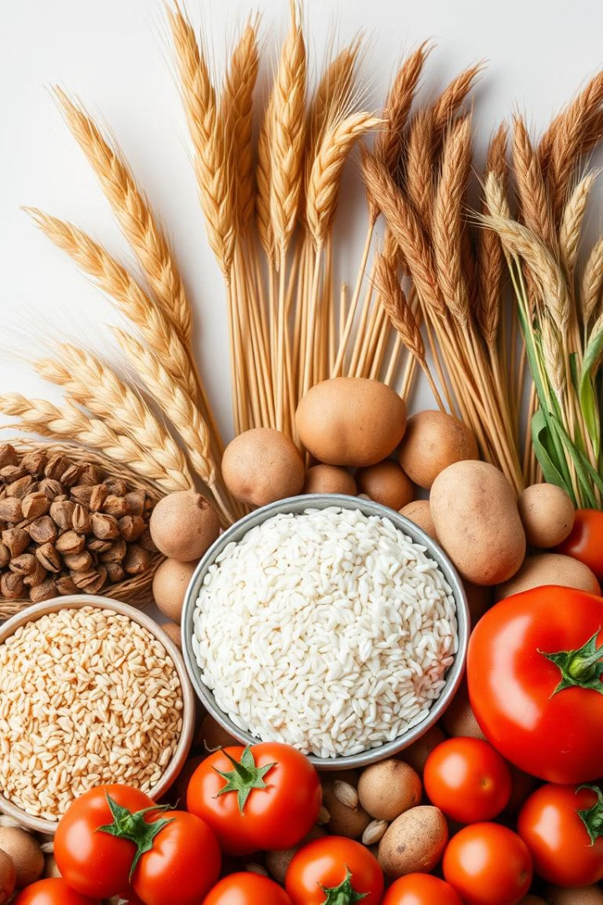
Crop Varieties and Grades
Crop
Common Varieties
Grades
Wheat
HD-2967, PBW-343
A, B, C
Potato
Kufri Jyoti, Kufri Chandramukhi
Grade 1, 2, 3
Rice
Basmati, IR-36
Grade A, Common
Tomato
Pusa Ruby, Arka Vikas
Premium, Standard

Slide 6
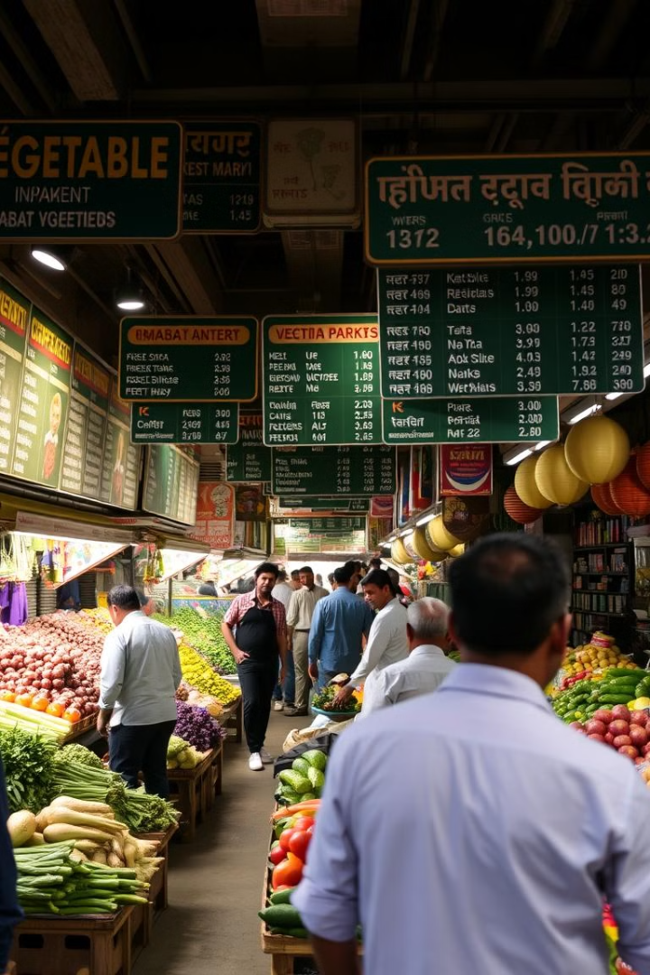



Market Price Components
Min Price
Lowest wholesale price per quintal, protecting farmers from extreme price drops.
Max Price
Highest wholesale price per quintal, indicating peak market value.
Modal Price
Most common wholesale price, representing the typical market rate.

Slide 7
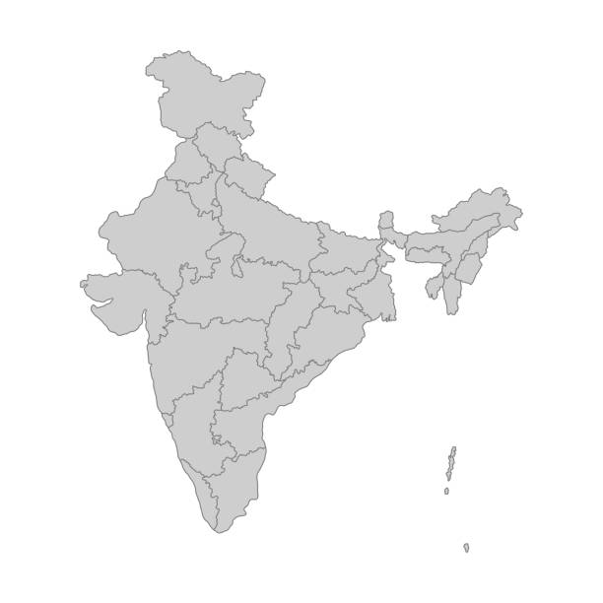
State-wise Market Analysis
West Bengal
Maharashtra
Major rice producer. Prices affected by local consumption and government policies.
Significant tomato cultivator. Prices vary due to seasonal demand and supply.
Punjab
Known for wheat production. Prices influenced by MSP and export demand.

Slide 8

District-level Price Variations
Local Factors
Storage Facilities
Transportation costs and local demand significantly influence district-level prices.
Districts with better storage infrastructure often see more stable prices.
Market Competition
Climate Impact
Number of buyers and sellers in a district affects price competitiveness.
District-specific weather conditions can cause short-term price fluctuations.

Slide 9




Crop Health Indicators
Leaf Color
MobileVNet analyzes leaf coloration to detect nutrient deficiencies or diseases.
Texture Analysis
It identifies unusual textures that may indicate pest infestations.
Growth Patterns
Abnormal growth patterns are detected to assess overall plant health.

Slide 10
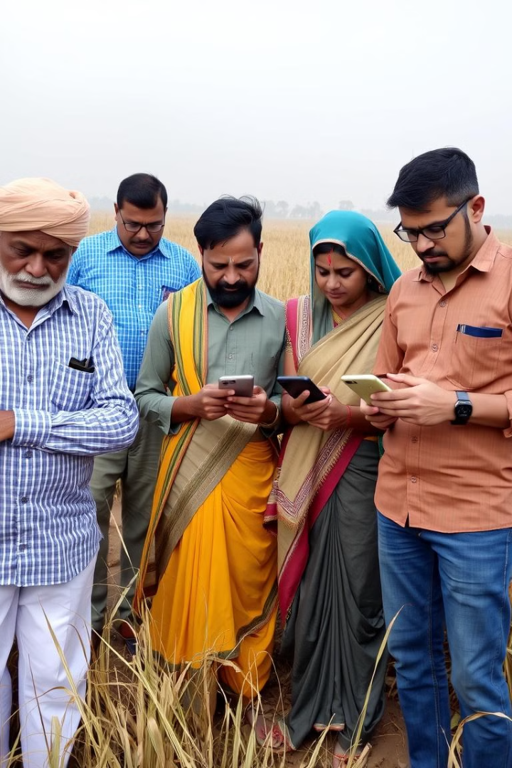
Benefits for Stakeholders
1
Farmers
2
Traders
Make informed decisions on crop management and market timing.
Gain insights into price trends for better inventory management.
3
Policymakers
4
Researchers
Access real-time data for effective agricultural policy formulation.
Utilize comprehensive datasets for advanced agricultural studies and innovations.

